Slide 1
Feasibility of Beam Reinforcement Optimization for Practical Application
Advisor : Prof. K.C.Chang
Presenters : You-Ran Nai
Notes:
Try 講清楚脈絡

Slide 2
Outline
Part 2
Part 4
Methodology
Seismic Verification
Part 1
Part 3
Objective
Condition

Slide 3
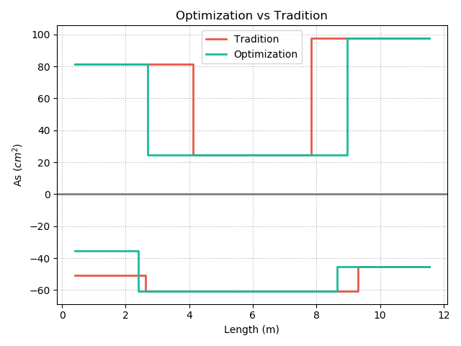
Top
12-#10
10-#10
REDUCE REBAR
3-#10
7-#8
9-#8
12-#8
Real
Demand
Bottom
Notes:
用最有感覺的圖

Slide 4
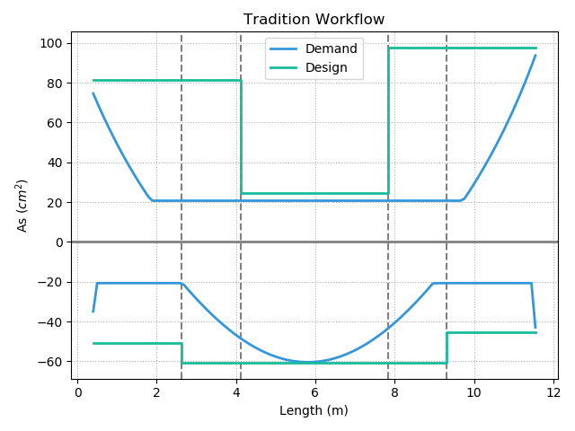
12-#10
10-#10
Today’s Solution
Fixed Bar-Cut
3-#10
10-#8
9-#8
12-#8
Notes:
LowSeismic4Floor12M 0

Slide 5
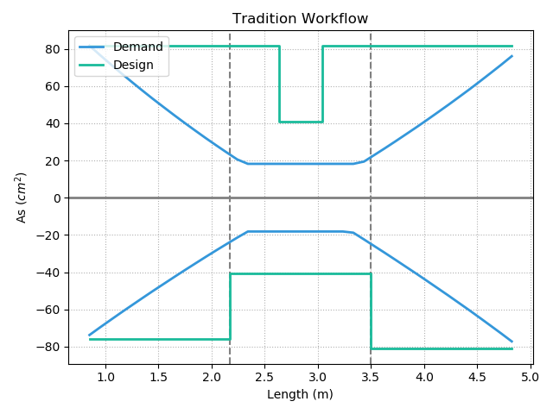
Today’s Solution
Notes:
欣銓 1140

Slide 6
Outline
Part 2
Part 4
Methodology
- Flexural
- Shear
Seismic Verification
Part 1
Part 3
Objective
Condition

Slide 7
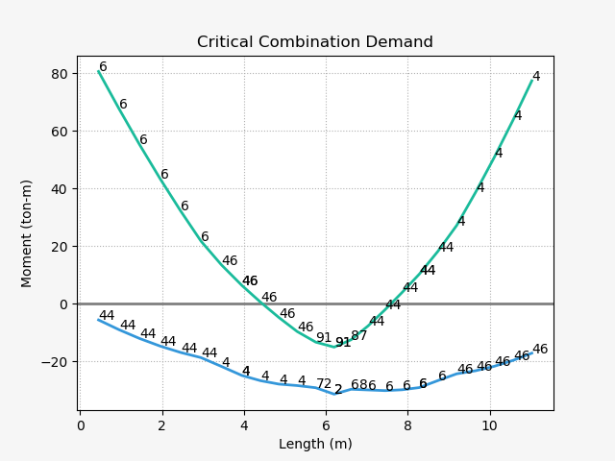
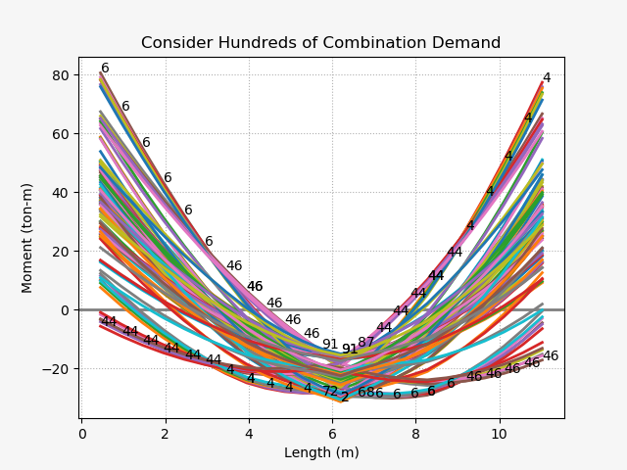
Design Moment - Mu
(1) U=1.4D
(2) U=1.2D + 1.6L
(3) U=1.2D + (1.0L or 0.5L)
(4) U=1.2D + 1.6W + (1.0L or 0.5L)
(5) U=1.2D + 1.0E + (1.0L or 0.5L)
(6) U=0.9D + 1.6W
(7) U=0.9D + 1.0E

Slide 8
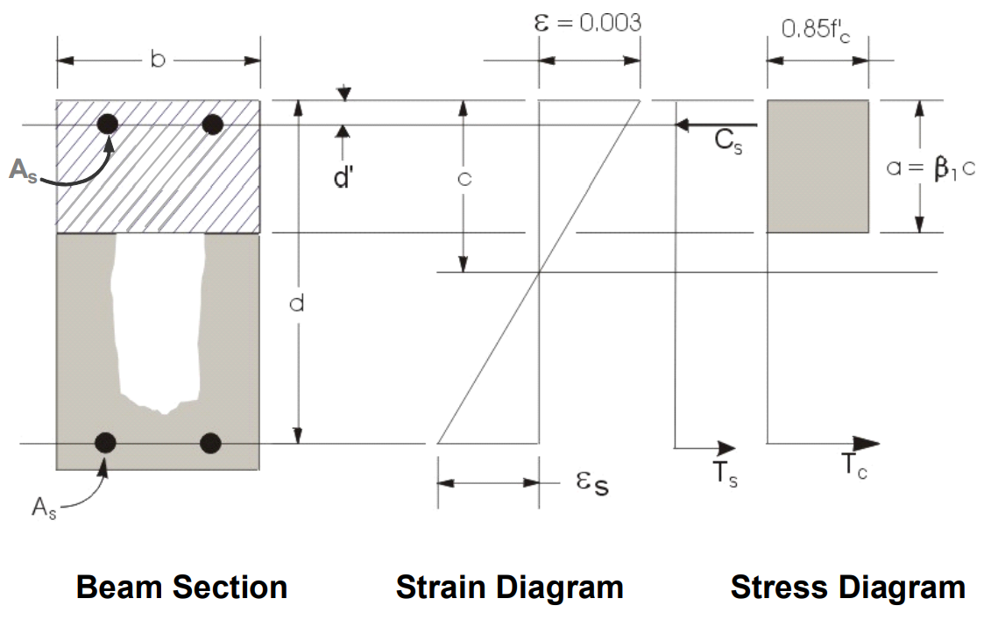
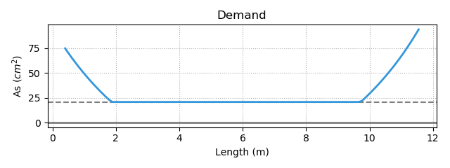
Flexural Reinforcement
- Demand As
Minimum Reinforcement
Notes:
LowSeismic 4Floor 12M 0

Slide 9
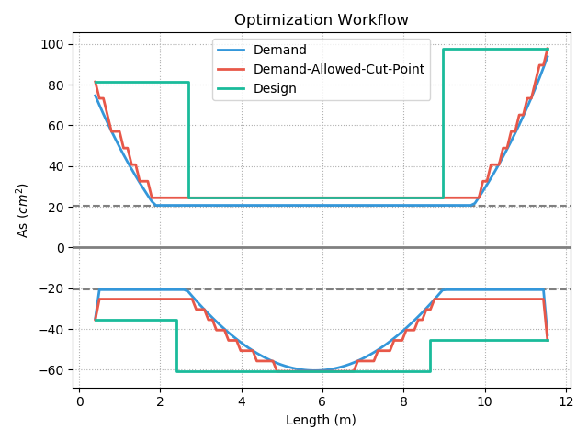
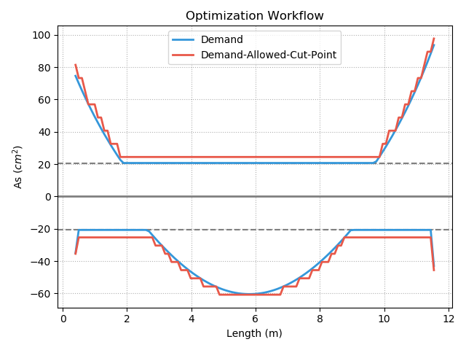
Procedure A

Slide 10
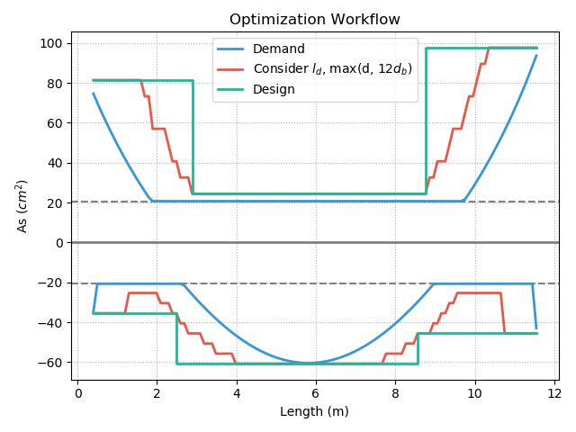
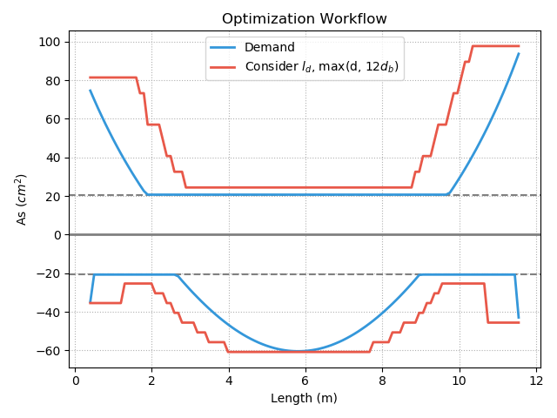
Procedure B

Slide 11
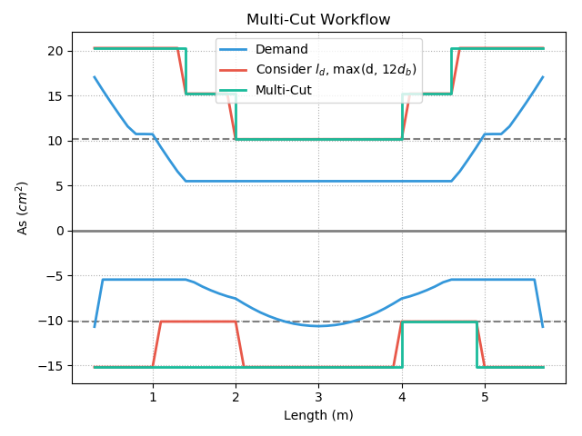
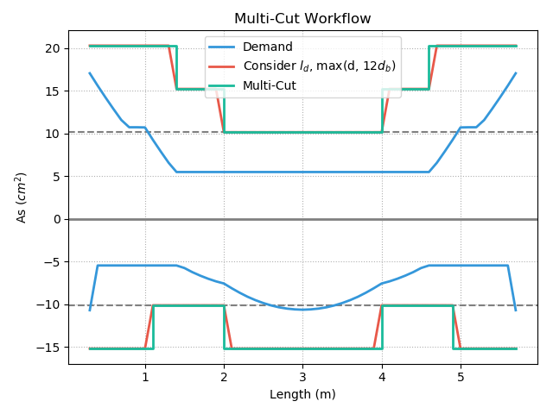
Multi-Cut
Top
Multi-Cut-4
Multi-Cut-2
Bottom
Notes:
GA 演算法
LowSeismic 4Floor 12M 4
LowSeismic 4Floor 12M 0

Slide 12
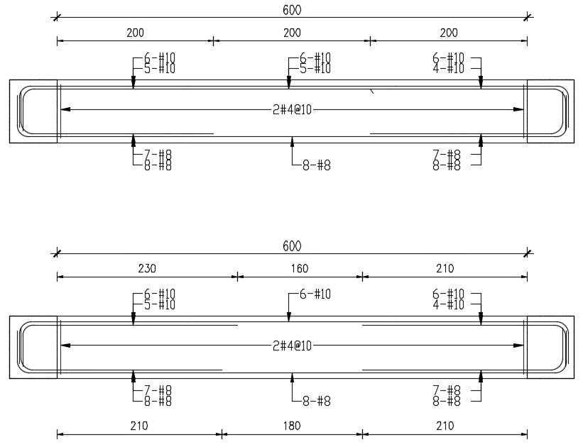
傳統梁鋼筋配置圖
最佳化梁鋼筋配置示意圖
Notes:
同第三頁的圖

Slide 13


Slide 14
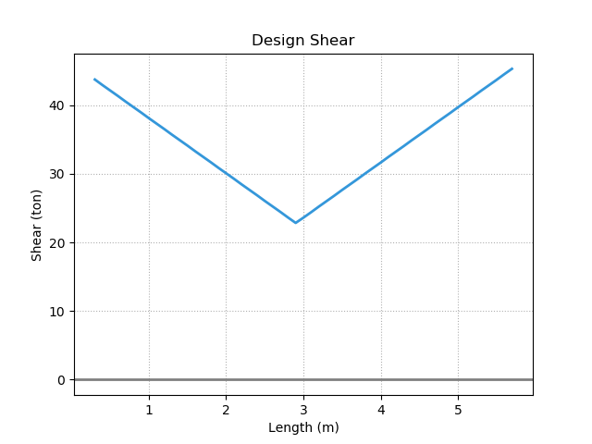
Design Shear - Vu
Notes:
LowSeismic4Floor12M 0

Slide 15
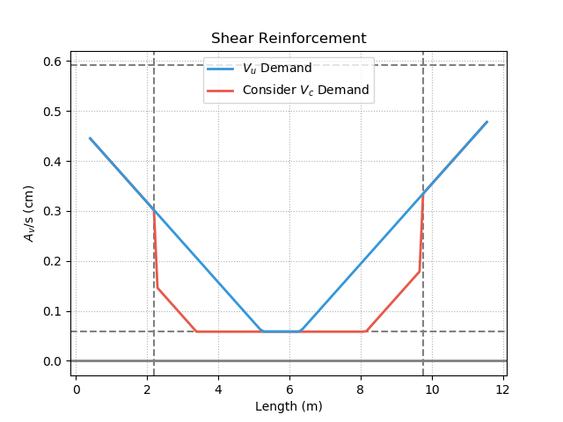
Shear Reinforcement
Notes:
LowSeismic4Floor12M 0

Slide 16
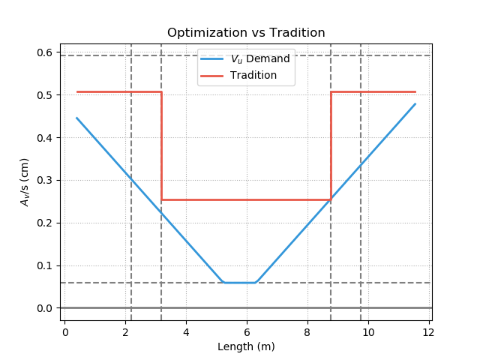
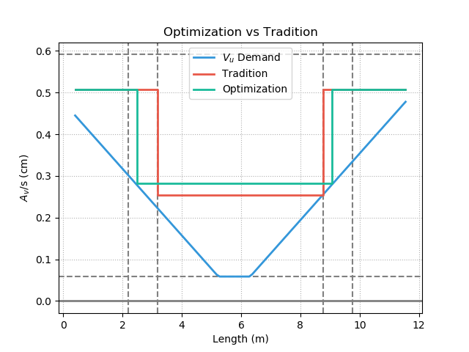
Shear Reinforcement
Notes:
LowSeismic4Floor12M 0

Slide 17
Outline
Part 2
Part 4
Methodology
Seismic Verification
Part 1
Part 3
Objective
Condition

Slide 18
Optimization vs Tradition
12-#10
10-#10
3-#10
7-#8
9-#8
12-#8
Notes:
同第3頁

Slide 19
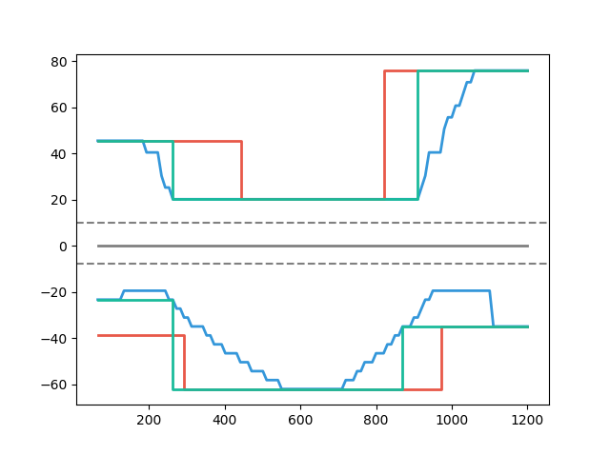
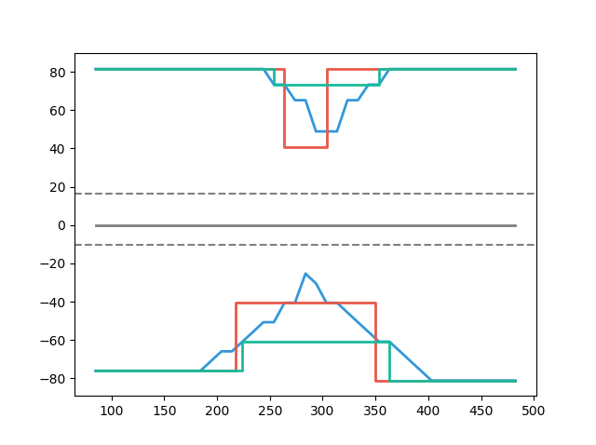
Multi-Cut-2 vs Tradition
- Tradition
- Consider Ld
- Tradition
- Consider Ld
- Multi-Cut-2
Multi-Cut-2 82%
Top
As(cm2)
As(cm2)
Multi-Cut-2 91%
Bottom
Length(cm)
Length(cm)
Notes:
傳統不經濟
828
傳統不保守 不符合 混凝土結構設計規範 401-100 R5.11.2
1140

Slide 20
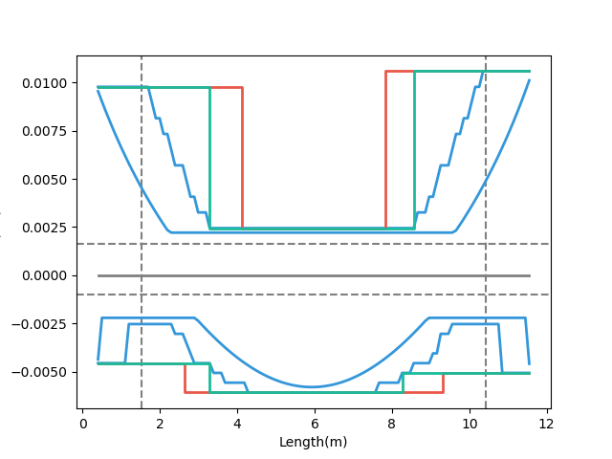
Factors
- Demand
- Tradition
- Multi-Cut-2
Moment
Consider Ld
Tradition

Slide 21
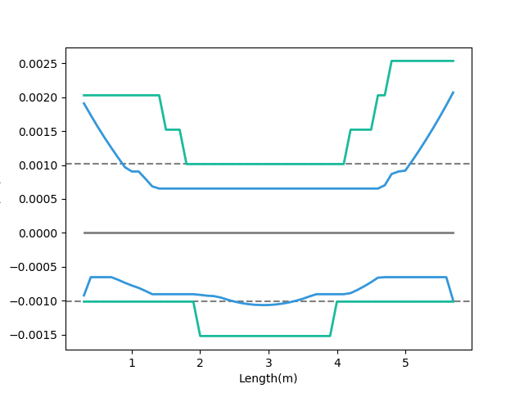
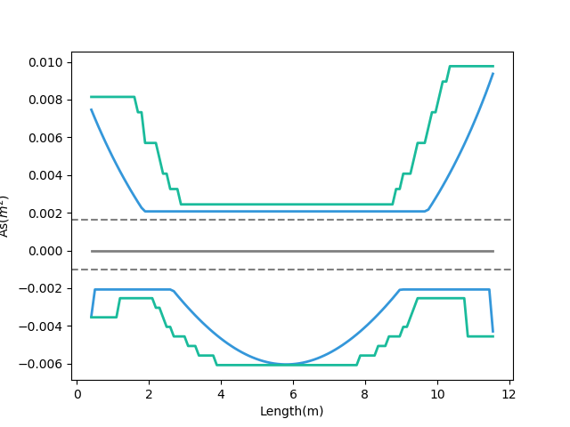
Ld
- Consider Ld
- Demand
Short Development Length
Ld
- Consider Ld
- Demand
Beam Length
Notes:
LowSeismic4Floor12M 0

Slide 22
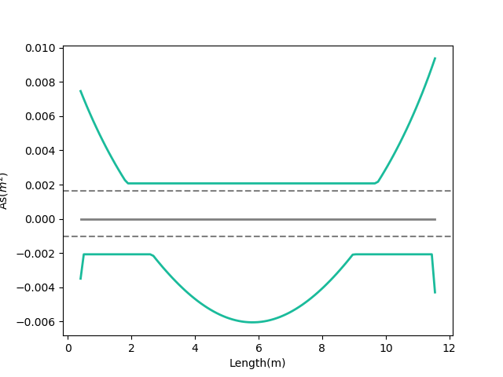
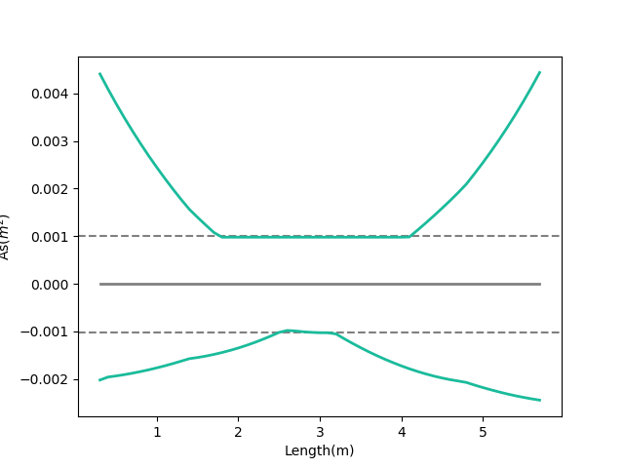
Moment Decay
- Moment Demand As
- Moment Demand As
Large Slope
Small Slope
Notes:
LowSeismic4Floor12M 0

Slide 23
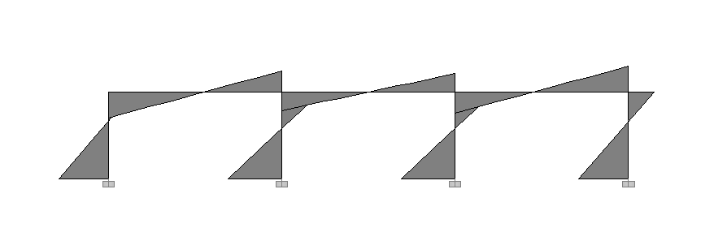
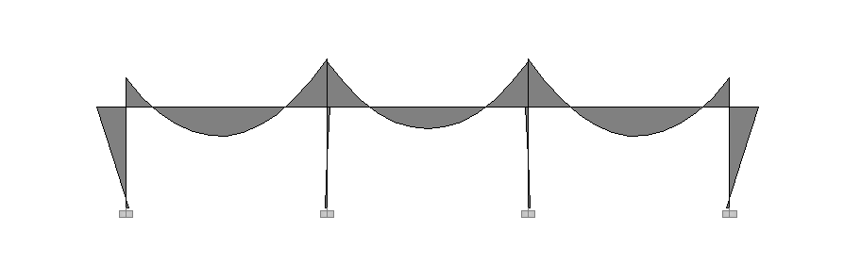
Lateral Load
Lateral
Force
Moment Diagram
Gravity Load
Gravity Load

Slide 24
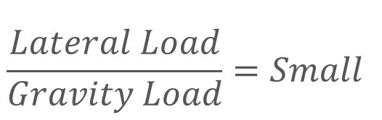
Lateral
Force
Moment Decay
$$\frac{Lateral Load}{Gravity Load}=Small$$
Gravity Load
Beam Length
Story Height

Slide 25
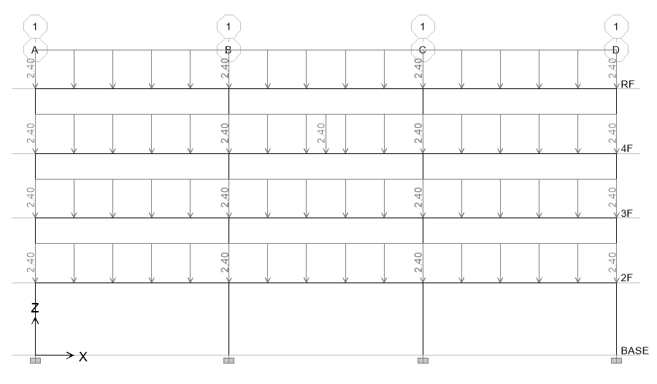
22 Models
4m
4.5m
Notes:
LowSeismic4Floor12M 0

Slide 26
Result
Beam Length
6m
9m
12m
High Seismic
99.6%
94.2%
92.1%
Site
Middle Seismic
99.6%
95.3%
91.0%
Low Seismic
98.1%
94.5%
90.4%

Slide 27
Result
Beam Length
6m
9m
12m
High Seismic
99.6%
94.2%
92.1%
Site
Middle Seismic
99.6%
95.3%
91.0%
Low Seismic
98.1%
94.5%
90.4%

Slide 28
Story Result
Beam Length
6m
9m
12m
Top Story
97.8%
93.7%
89.8%
Bottom Story
100.2%
95.5%
92.3%

Slide 29
Bottom Result
Beam Length
6m
9m
12m
High Seismic
97.2%
89.0%
95.1%
Site
Middle Seismic
91.9%
94.3%
97.2%
Low Seismic
96.0%
99.4%
96.5%

Slide 30
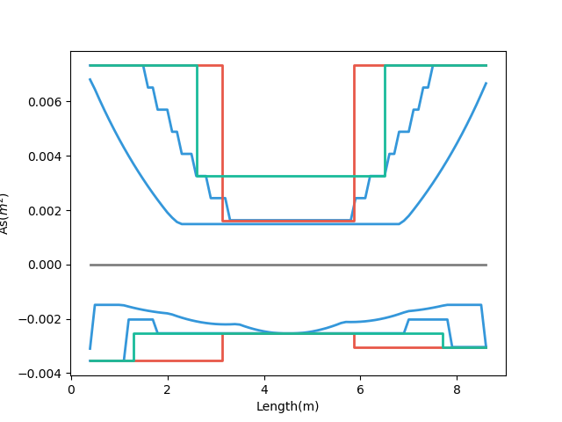
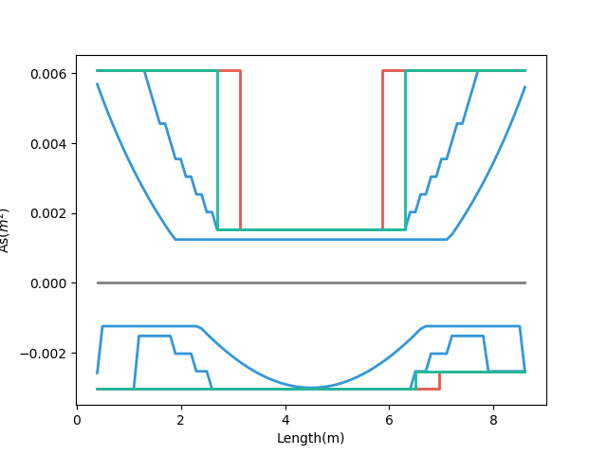
Why?
- Demand
- Tradition
- Multi-Cut-2
- Demand
- Tradition
- Multi-Cut-2
Small Gravity 89%
Bottom
Large Gravity 99%
5-#8
6-#8
5-#8
7-#8
6-#8
6-#8
High Seismic
Low Seismic
Notes:
HighSeismic 4Floor 9M 12
LowSeismic 4Floor 9M 12

Slide 31
#8 => #10
2.54cm => 3.22cm
6m
9m
12m
High Seismic
98.9%
102.2%
99.4%
Site
Middle Seismic
97.5%
100.5%
100.0%
Low Seismic
97.8%
101.7%
101.2%

Slide 32
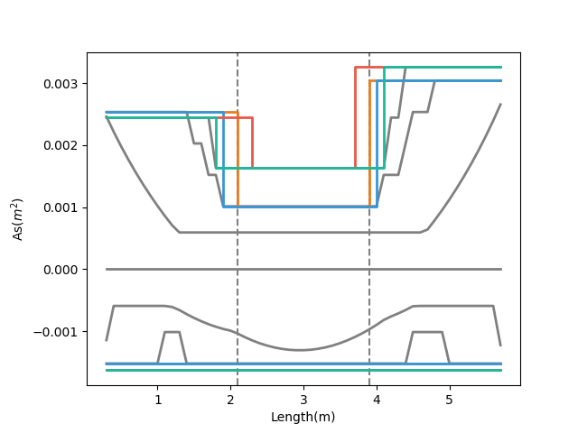
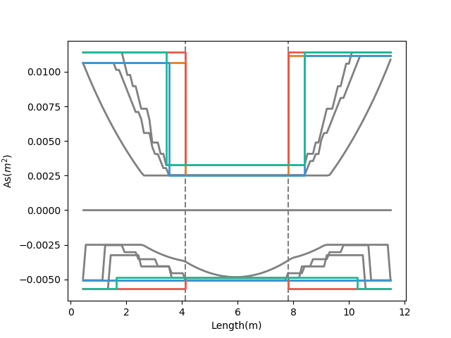
- Tradition, #8
- Tradition, #10
- Tradition, #8
- Tradition, #10
- Multi-Cut-2, #8
- Multi-Cut-2, #10
- Multi-Cut-2, #8
- Multi-Cut-2, #10
Notes:
MidSeismic 4Floor 6M 0
HighSeismic 4Floor 12M 12

Slide 33
Stories Result
Top
Bottom
Total
4
96.0%
94.3%
95.3%
Stories
12
95.3%
91.5%
93.8%
20
99.2%
93.6%
97.0%

Slide 34
Stirrups Result
Beam Length
6m
9m
12m
High Seismic
101.4%
92.0%
90.2%
Site
Middle Seismic
96.6%
94.4%
87.0%
Low Seismic
93.3%
94.1%
94.5%

Slide 35
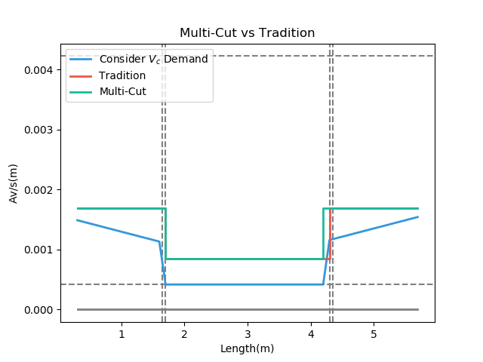
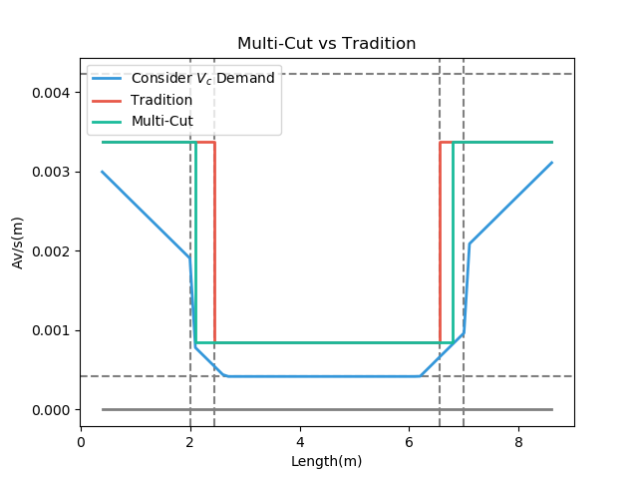
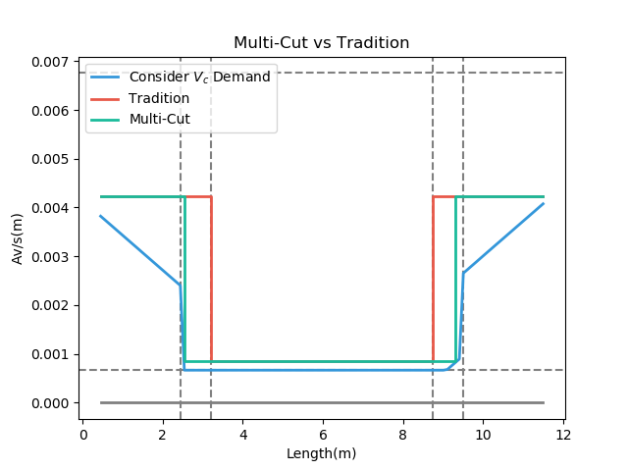
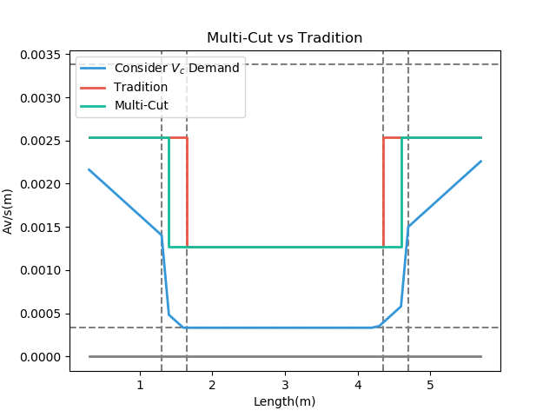
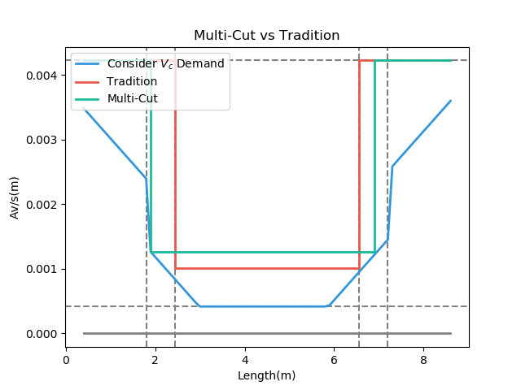
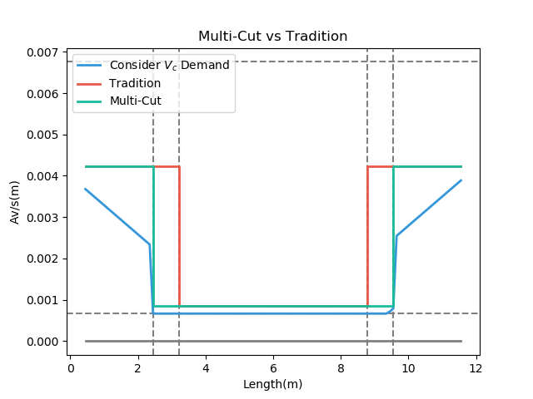
High Seismic 6m
High Seismic 9m
High Seismic 12m
Mid Seismic 6m
Mid Seismic 9m
Mid Seismic 12m
Notes:
LowSeismic 4Floor 12M 0

Slide 36
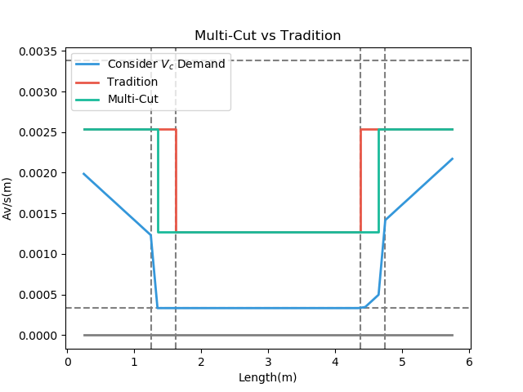
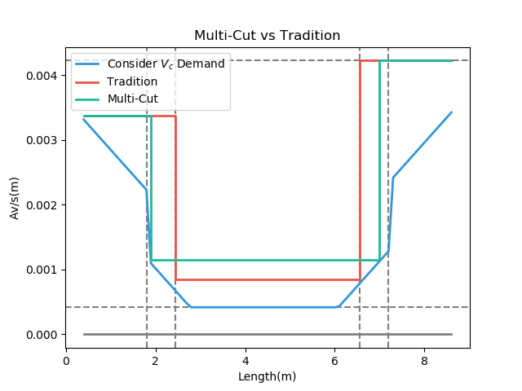
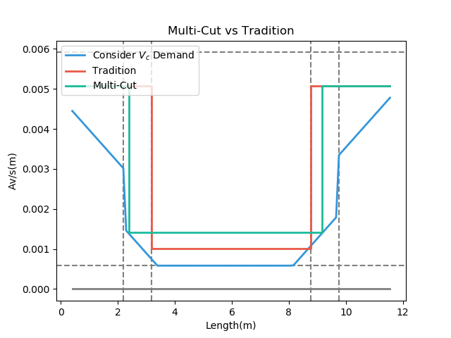
Low Seismic 6m
Low Seismic 9m
Low Seismic 12m
Mid Seismic 6m
Mid Seismic 9m
Mid Seismic 12m

Slide 37
More Multi-Cut
2
3
4
5
Unlimited
Notes:
理論最佳解

Slide 38
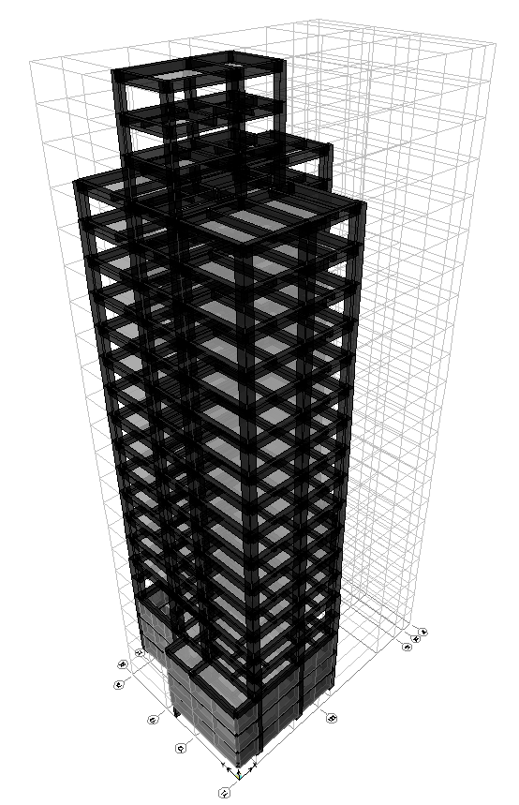
台北住宅案
100.0%
OVERALL RESULT
14F B3
101.3%
TOP RESULT
98.5%
BOT RESULT
20m
30m
Notes:
由於很複雜，先記得最終的結果
400

Slide 39
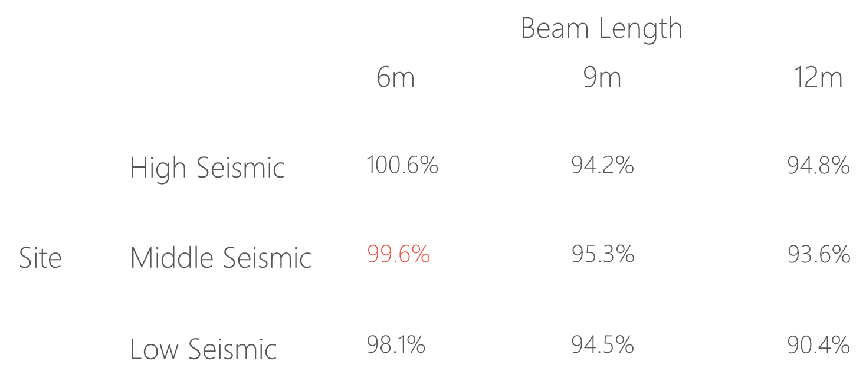
台北住宅案

Slide 40
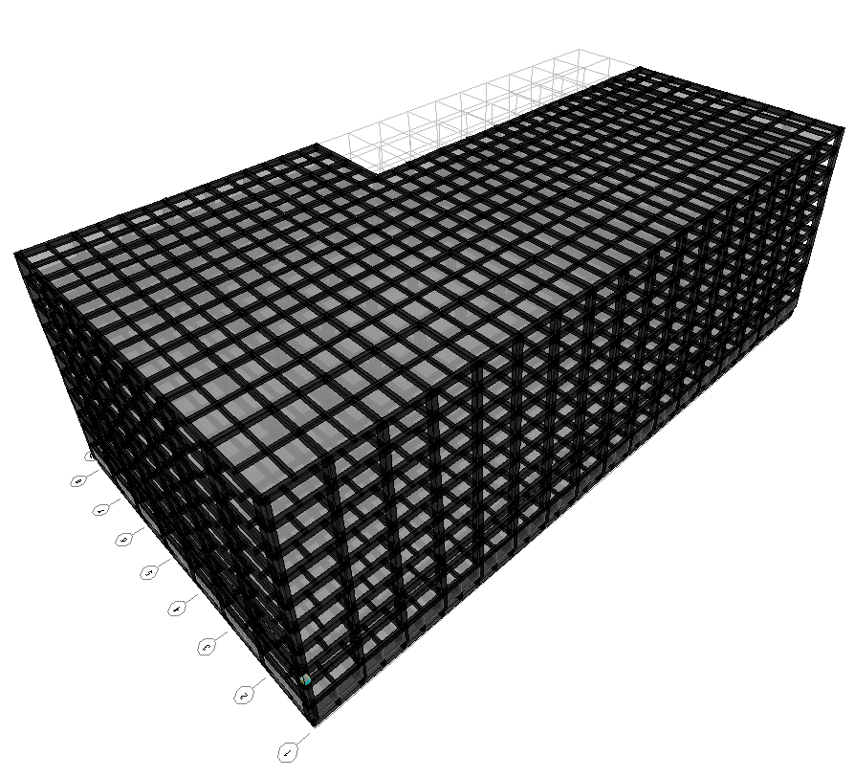
9F B1
93.4%
OVERALL RESULT
92.3%
TOP RESULT
153m
77m
94.7%
BOT RESULT
高雄物流中心
Notes:
3500

Slide 41
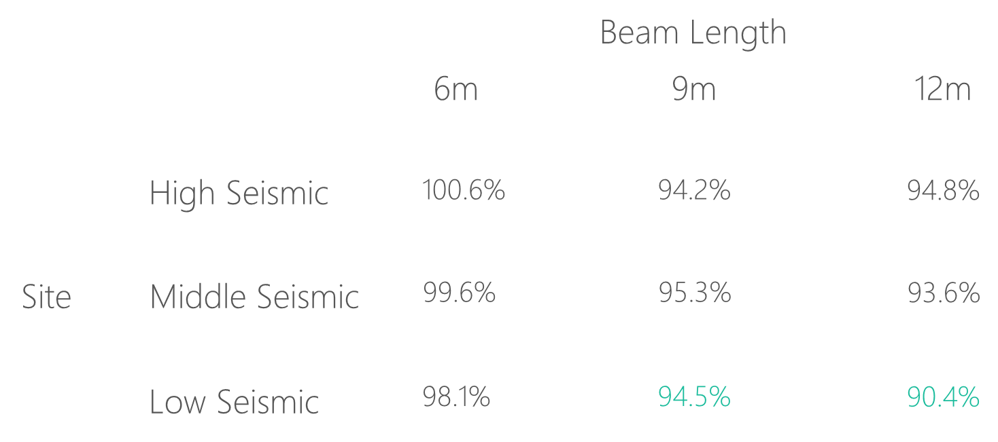
高雄物流中心

Slide 42
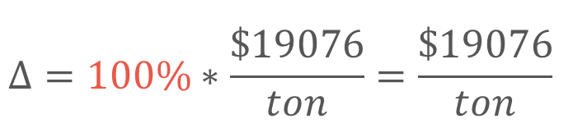
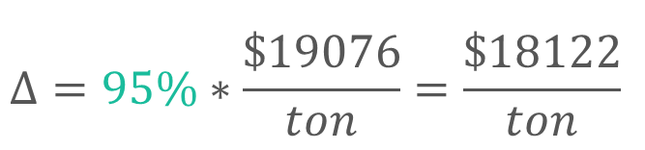
Material Cost
Tradition
Multi-Cut
$$Δ=100\%∗\frac{\$19076}{ton}=\frac{\$19076}{ton}$$
$$Δ=95\%∗\frac{\$19076}{ton}=\frac{\$18122}{ton}$$
Material Cost
Reduced Percentage
資料來源: 公共工程價格資料庫 2019

Slide 43
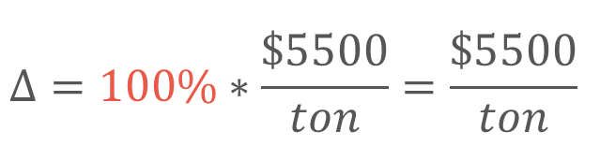
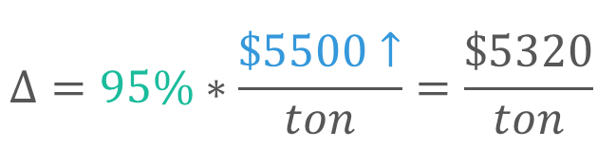
Construction Cost
Tradition
Multi-Cut
$$Δ=100\%∗\frac{\$5500}{ton}=\frac{\$5500}{ton}$$
$$Δ=95\%∗\frac{\$5500↑}{ton}=\frac{\$5320}{ton}$$
鋼筋綁紮工資
複雜度增加 => 鋼筋綁紮工資增加
資料來源: 台北市公共工程 2019

Slide 44






Cost Analysis
Tradition
Multi-Cut
$$100\%∗\frac{\$19076}{ton}=\frac{\$19076}{ton}$$
$$95\%∗\frac{\$19076}{ton}=\frac{\$18122}{ton}$$
Material Cost
Construction Cost
$$100\%∗\frac{\$5500}{ton}=\frac{\$5500}{ton}$$
$$95\%∗\frac{\$6794}{ton}=\frac{\$6454}{ton}$$
Total Cost
$$100\%$$
$$100\%$$

Slide 45






Cost Analysis
Multi-Cut-2
Tradition
Multi-Cut-2
$$100\%∗\frac{\$19076}{ton}$$
$$95\%∗\frac{\$19076}{ton}$$
Material Cost
Construction Cost
$$100\%∗\frac{\$5500}{ton}$$
$$95\%∗\frac{\$5500}{ton}$$
Total Cost
$$100\%$$
$$95\%$$

Slide 46
Outline
Part 2
Part 4
Methodology
Seismic Verification
Part 1
Part 3
Objective
Condition

Slide 47


12-#10
Consider Ld
12-#10
10-#10
10-#10
Top
3-#10
3-#10
7-#8
7-#8
9-#8
Bottom
9-#8
12-#8
12-#8

Slide 48


Pushover Method
ATC-40 Capacity Spectrum
Modal Pushover Analysis
Multi-Modes Combination
Mode Shape
Effective Mass
SRSS
Notes:
定義非線性驗證的邊界

Slide 49
ATC-40 Capacity Spectrum
Tradition
Multi-Cut-2
Notes:
Low Seismic 12m 90.4%

Slide 50
Modal Pushover Analysis - Tradition
Mode 1
Mode 2

Slide 51
Modal Pushover Analysis – Multi-Cut
Mode 1
Mode 2

Slide 52
Modal Pushover Analysis - SRSS
Tradition
Multi-Cut-2

Slide 53
Multi-Modes Combination
Tradition
Multi-Cut-2

Slide 54




Step 2
Step 3
Step 5
Step 7

Slide 55
Gravity Load
Forth Hinge
Gravity Load
+
Lateral Load

Slide 56



Without Gravity Load
First Hinge

Slide 57

Time History Analysis
Story Drift
Scaled to DBE, MCE
- Time History Spectrum
- DBE Spectrum
- MCE Spectrum
DBE < 1.5%
MCE < 2%

Slide 58


DBE < 1.5%
Low Seismic 12m 90.4%
Tradition
Multi-Cut-2

Slide 59


MCE < 2.0%
Low Seismic 12m 90.4%
Tradition
Multi-Cut-2

Slide 60




Tradition DBE
Multi-Cut-2 DBE
換圖
Tradition MCE
Multi-Cut-2 MCE
Notes:
DBE 1602 11.5
MCE 1116 15.5

Slide 61





Slide 62


Incremental Dynamic Analysis
Single Static Analysis
➔
Incremental SPO
Single Time History Analysis
➔
Incremental One

Slide 63

Non-Linear SPO
Elastic
➔
Match
Non-Negative
➔
Equal Displacement
Negative
➔
Softening

Slide 64

Pushover and IDA too much difference

Slide 65


Another way IM: Base Shear

Slide 66
SF: 0.5
SF: 2.5
SF: 4.5
SF: 6.5
SF: 8.5
SF: 10

Slide 67

Result

Slide 68


Limit-State
4% FEMA273
2.5% SEAOC2000

Slide 69


IDA
Low Seismic 12m 90.4%
Log

Slide 70
Conclusion
Condition
Verification
Long Span
Low Seismic
Capacity Close To Tradition
Objective
Construction
Reduce Rebar
Today or Future Cost

Slide 71





Mu
Consider Hundreds Of Combo Demand
Critical Demand Combo
$$A_{s}({cm}^{2})$$
$$A_{s}({cm}^{2})$$
Length(m)
Length(m)

Slide 72


Design Moment - Mu
(1) U=1.4D
(2) U=1.2D + 1.6L
(3) U=1.2D + (1.0L or 0.5L)
(4) U=1.2D + 1.6W + (1.0L or 0.5L)
(5) U=1.2D + 1.0E + (1.0L or 0.5L)
(6) U=0.9D + 1.6W
(7) U=0.9D + 1.0E

Slide 73


Design Moment - Mu
(1) U=1.4D
(2) U=1.2D + 1.6L
(3) U=1.2D + (1.0L or 0.5L)
(4) U=1.2D + 1.6W + (1.0L or 0.5L)
(5) U=1.2D + 1.0E + (1.0L or 0.5L)
(6) U=0.9D + 1.6W
(7) U=0.9D + 1.0E

Slide 74




General Development Length Equation
Procedure A
MIN
Simplified Provisions

Slide 75
General Development Length Equation
Procedure A
MIN
Simplified Provisions

Slide 76

傳統梁鋼筋配置圖
最佳化梁鋼筋配置示意圖
Notes:
LowSeismic 4Floor 12M 0

